Slide 1


ECE484 FA26 MP3 Walkthrough
Drone Kalman Filter Localization
Yuxi Chen, Hanna Chen, Taowei Huang, Eric Ji, Vishesh Prasad, Junsheng Huang
October 16, 2026

Slide 2
Outline
Logistics
  Pitch Presentations 10/20 and 10/22
  Make sure to do your in-person safety trainings (if applicable)
  Start working early on your final projects
HW3 (individual, as always)
MP3 (within your MP Group, not final project groups, as always)
Both due on 11/13

Slide 3
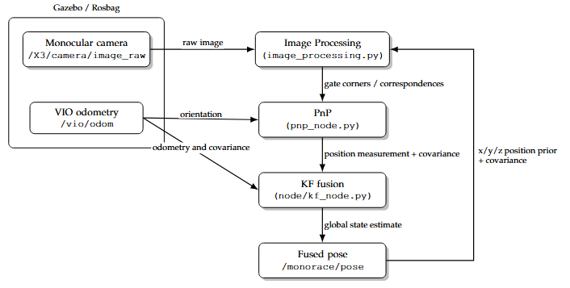
MP3 Pipeline
Overall Objective: Implement a pipeline to localize drone in a drone racing environment with known gate positions.
VIO odometry simulates
visual odometry output
  Estimates are imperfect
  Will drift over time
  Noise can be modeled with
  Gaussian uncertainty
Your group will work on all 3 stages:
  Image Processing
  PnP
  Kalman Filter Fusion

Slide 4
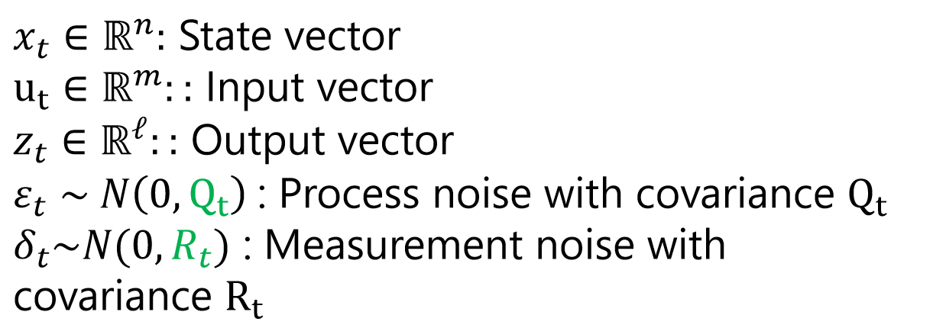
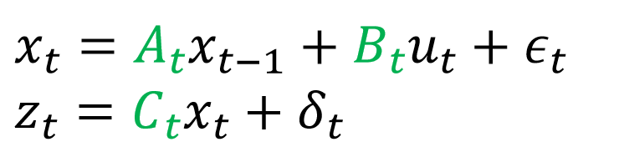
Kalman Filter Background
A state estimation algorithm for linear systems with Gaussian uncertainty.
Predicts the next state of the system and updates that estimate whenever a new measurement arrives.
KF assumes that the system evolves according to a linear Gaussian state-space model as follows.
Slides from Spring 2026: https://safeautonomy-illinois.github.io/ece484-site/assets/pdfs/spring-2026/Spring26_Lecture13_KF.pdf

Slide 5
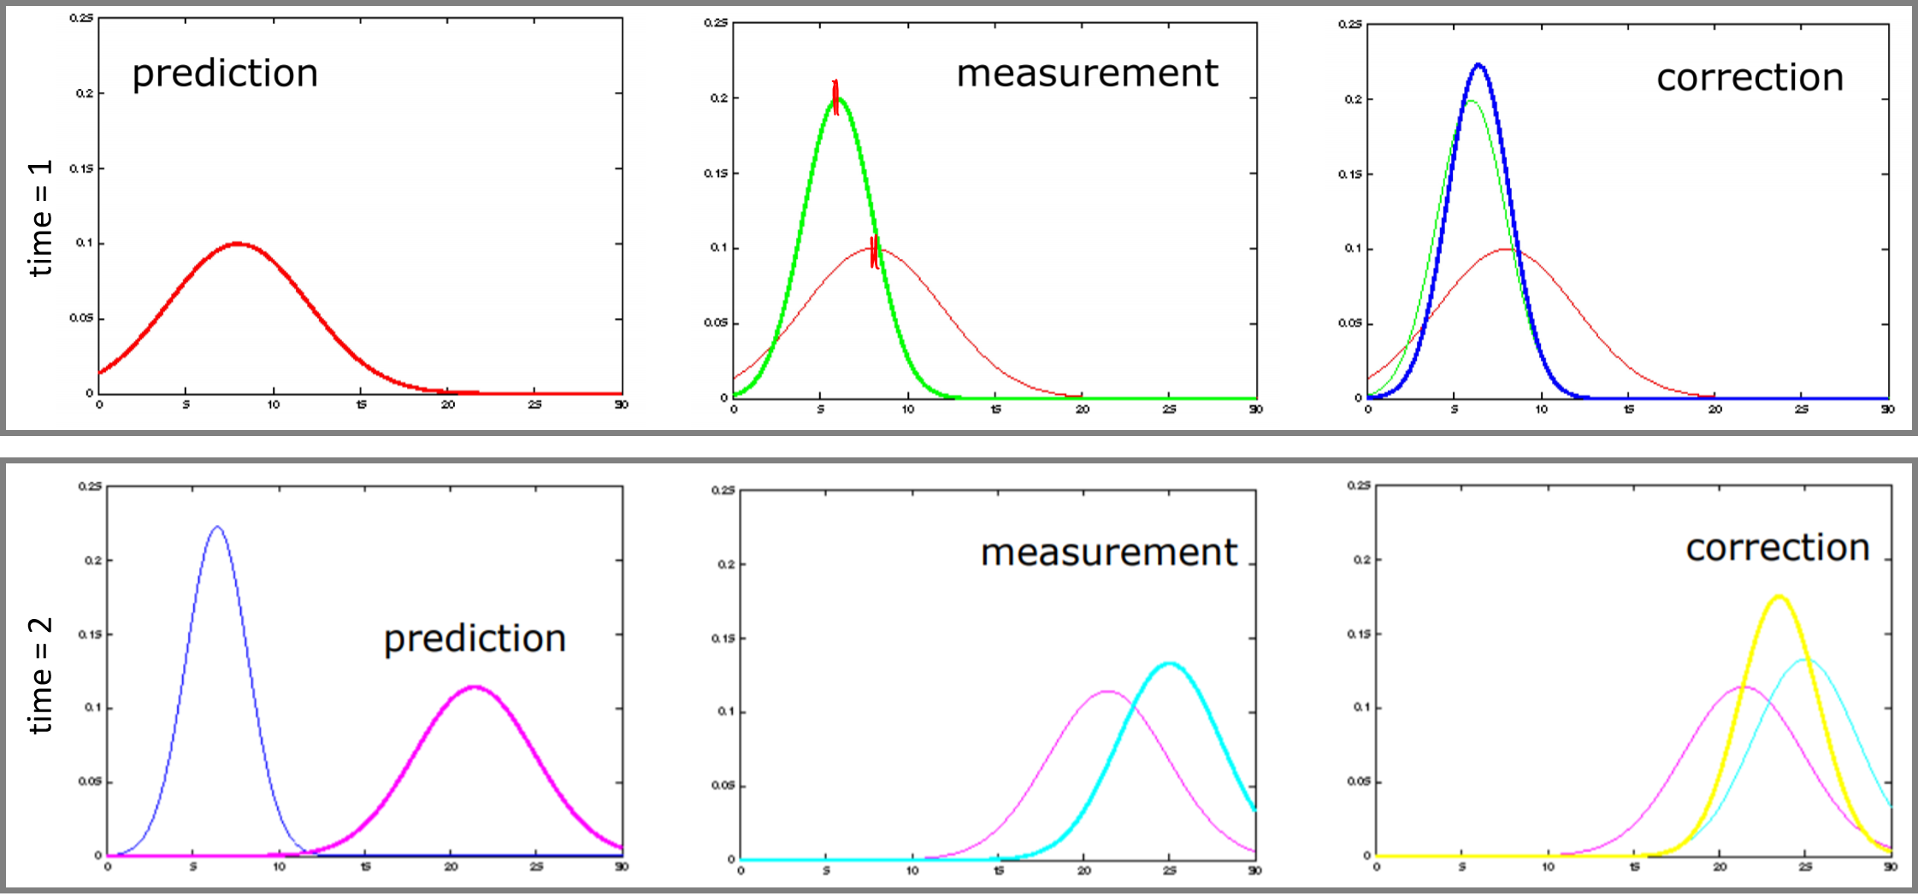
Kalman Filter Background
Prediction, measurement, and corrected state estimates are each represented as Gaussian distributions. Keep in mind that for the Kalman Filter, these steps do not have to occur in this exact order!!
Notes:
Time 1: Has a prediction. Then measurement is received and there is a correct.
Time 2: Based on motion model/motion, new prediction in pink. Then a measurement comes in. Correction is then computed from predicted state and correction

Slide 6
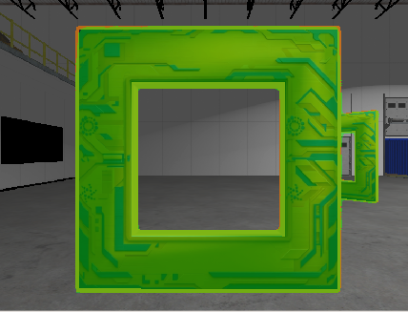
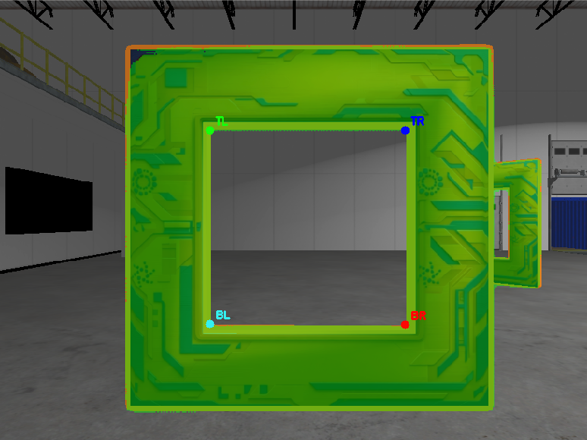
Image Processing and Perspective-N-Points (PnP)
Gate Segmentation
Corner Detection
Since map and gate positions are known, 2D pixel coordinates to 3D world coordinates of gate corners can be computed.
Perspective-N-Points uses these correspondences to compute camera pose in world frame.
*Segmentation, Corner detection, and PnP solve are provided.
Notes:
Technically inner and outer corners are detected, but not too important for student to know

Slide 7
Coordinate Frames
World Frame W: fixed frame of the gate map, z up
Base Frame B: attached to the drone body, x forward, y left, z up
Camera Frame C: OpenCV camera frame, z out of the lens, x right, y down
T_{AB} maps coordinates in frame B into frame A
In the code, T_{AB} is written T_a_b
  T_world_base = T_{WB}: the drone pose
  T_base_cam = T_{BC}: the camera extrinsics

Slide 8
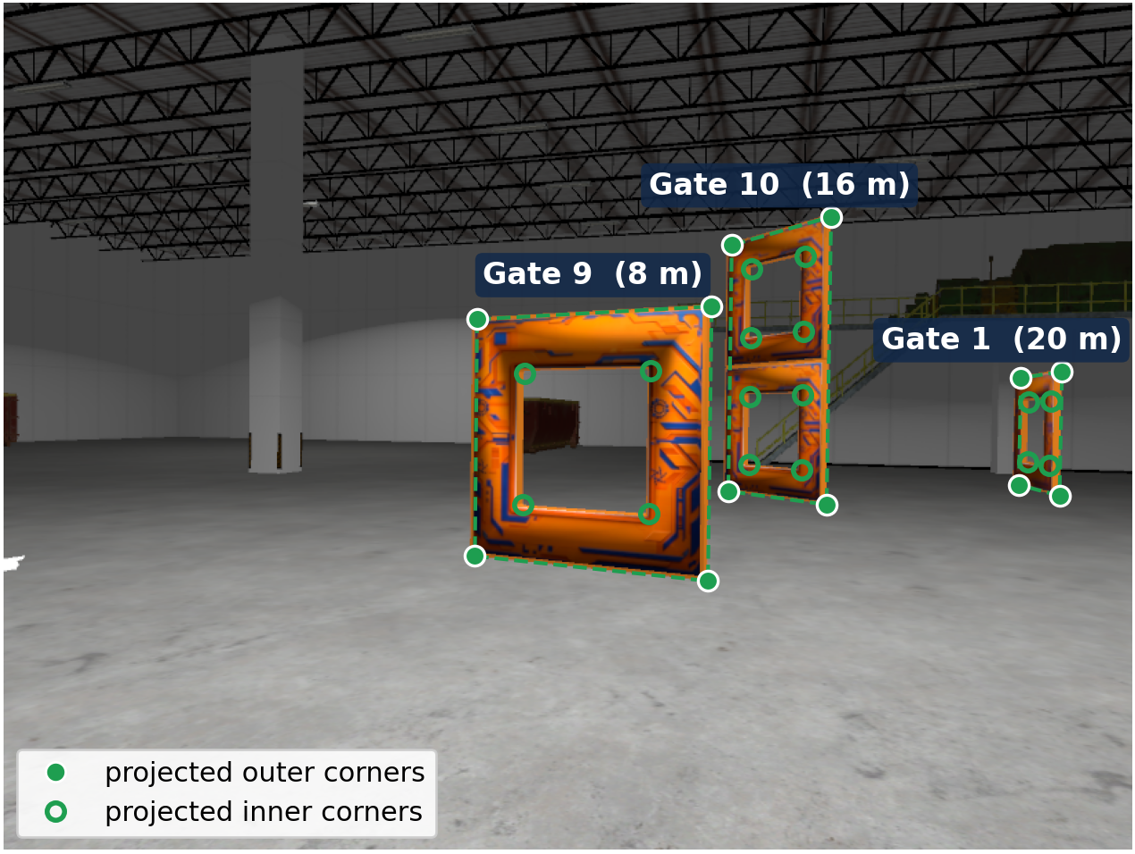
Image Processing: project_points()
Predict where known gate corners should appear in the camera image. The predictions help with corner detection and gate matching.
Input: 3D position of gate corners in the world, drone pose T_{WB}, camera extrinsic T_{BC}, camera matrix K
Output: pixel coordinates, and the corresponding points in the camera frame
Notes: Do not use cv2.projectPoints

Slide 9
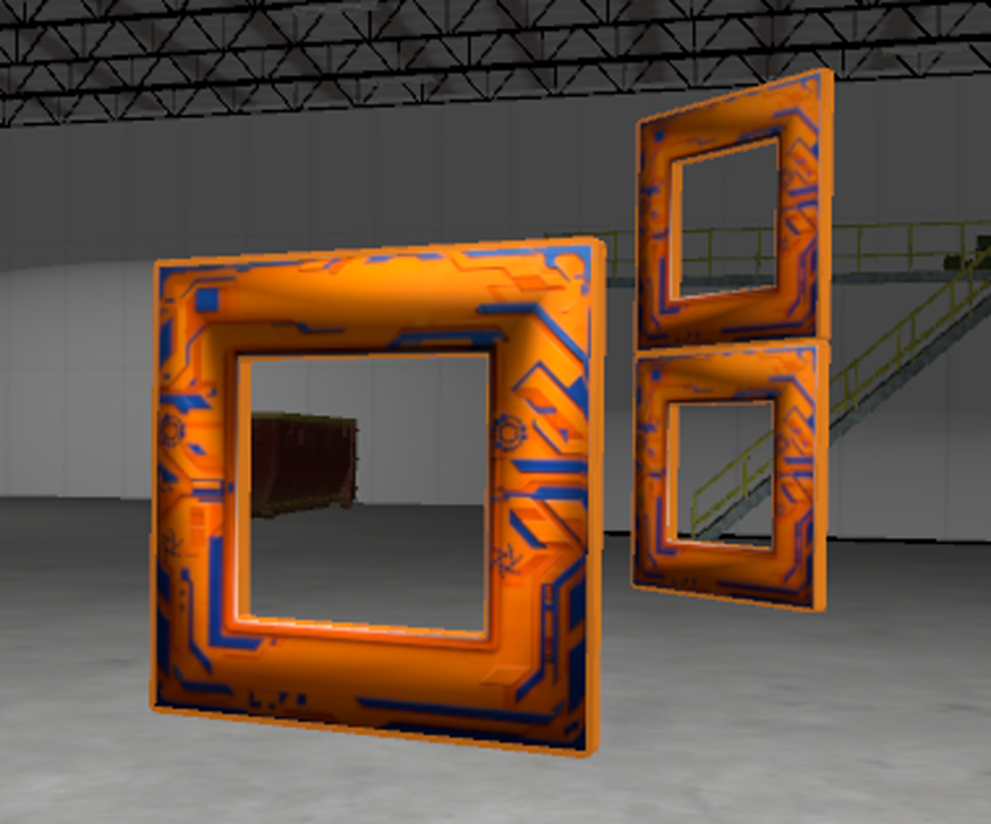
Image Processing: project_position_uncertainty()
KF position belief (Gaussian)
pixel belief (≈ Gaussian)
The Kalman Filter models the drone's position as a Gaussian.
Using this pose to project gate centers onto the image gives each predicted gate an approximately Gaussian spread in pixels.
The pixel σ decides how far from the prediction a detection can be and still match the gate.
dashed: ±σ
σ = 0.3 m
far gate (15 m)
σ = 11 px
near gate (8 m)
σ = 21 px
projected onto the image
Search region around each predicted gate

Slide 10
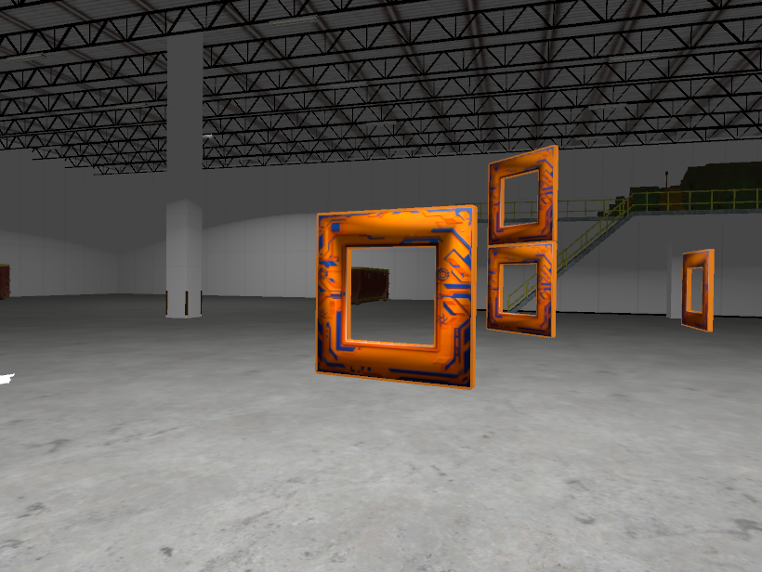

Image Processing: associate_detections()
1
Map (top-down)
Segmentation finds gates in the image but not which gate it is in the map.
You will need match them to the gates predicted from the Kalman Filter pose.
Use a cost function to assign costs from each detected gate to the gates in the map
Match one-to-one lowest cost pairs
10
2
gate 10
gate 9
9
3
gate 1
#3 cost 1.6
#2 cost 1.1
#1 cost 0.9
8
6
drone
4
7
5
$$Cost=\frac{|det_center−pred_center|}{uncertainty}$$
detected gate center (from segmentation)
3σ circle: reject if cost > 3
detected gate blob
N
gate number, same as in the map
predicted gate center (from KF)
predicted gate outline

Slide 11
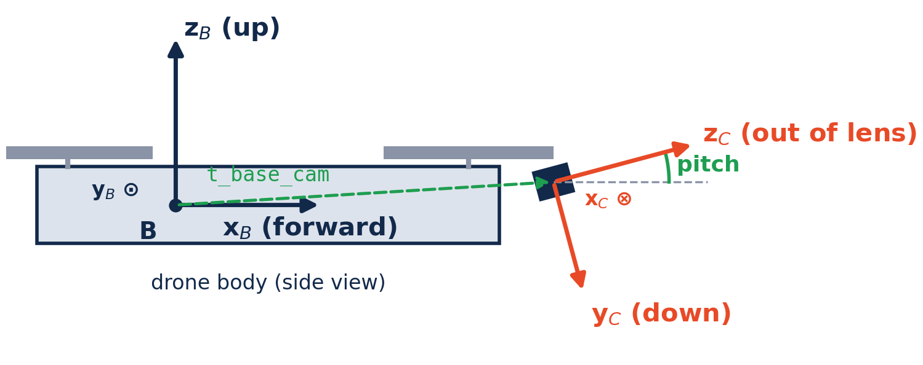
PnP Data Augmentation
build_T_base_cam()
Outputs the camera extrinsics T_{BC}, where the camera sits on the drone
Body_pose_from_pnp()
Outputs drone pose T_{WB}
PnP solves for the camera pose relative to the gates, but the Kalman Filter uses drone body pose

Slide 12
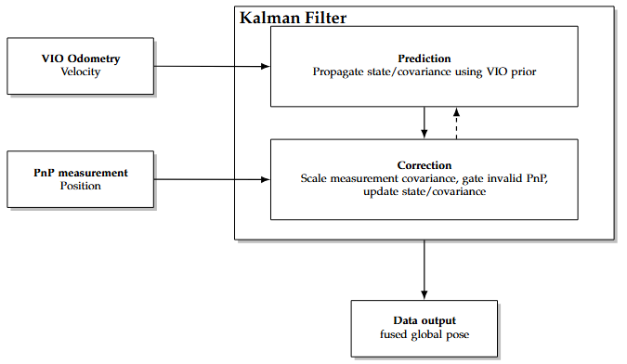
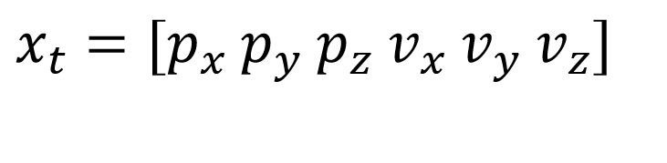
Kalman Filter
In this MP, the Kalman Filter will fuse position and velocity, so the state is:
Stores the state estimate as a mean and covariance
State continuously propagated as VIO Odometry published
State updated as PnP measurement published

Slide 13
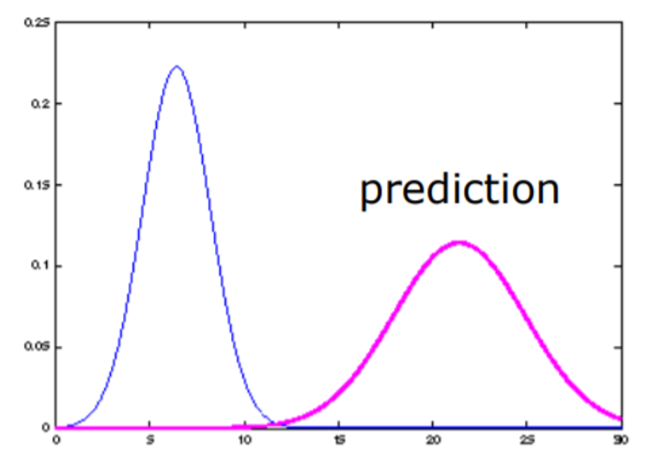
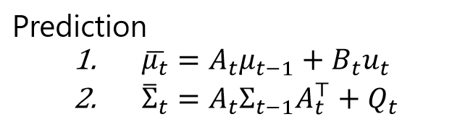
Prediction Step (On VIO Odometry input)
prior
Notes:
Blue is prior, pink is prediction after motion update (in this case input would be VIO odometry velocity)

Slide 14
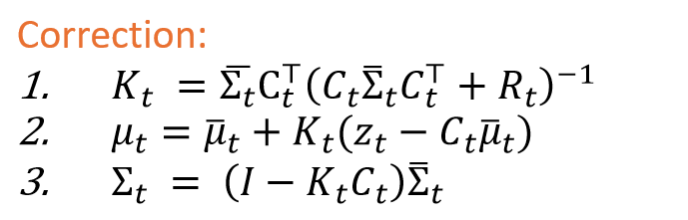
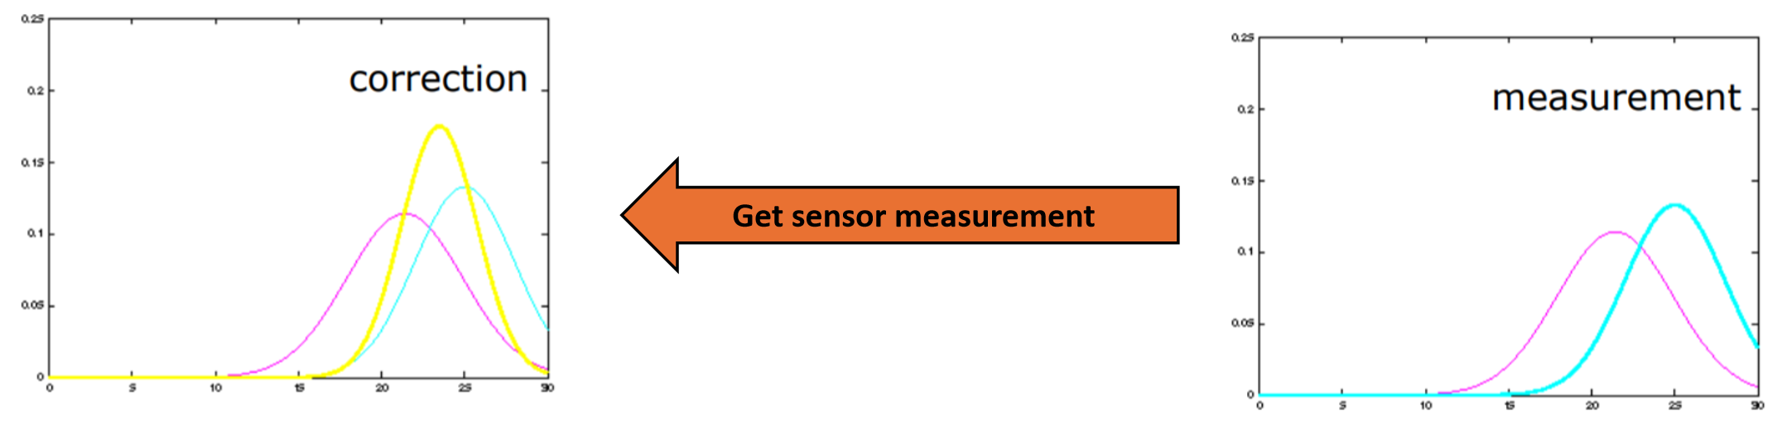
Update/Correction Step (On PnP pose input)
Notes:
Measurement in blue, prior in pink. Corrected state in yellow

Slide 15
Rosbag/Gazebo
Rosbags replay previously recorded topics in time order
    You will be evaluated on two Rosbags.
  Gazebo simulator also provided for your testing purposes. We will NOT be evaluating through Gazebo
    Gazebo environment contains the same gate configuration as the one in Rosbags

Slide 16
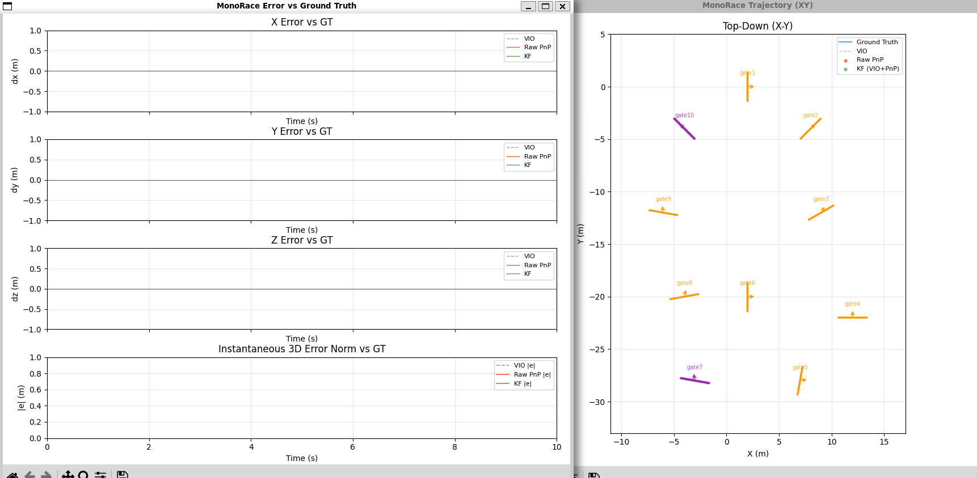
Metrics
Position estimation error: X/Y/Z errors with reference to Ground Truth
RMSE (Root mean square error) with reference to ground truth
Notes:
Plots will be provided

Slide 17
Grading
HW (100 pts)
MP3 (100pts)
  Report 80 pts
  Demo 20 pts

Slide 18


